Slide 1


CALL DOC
G.H.PATEL COLLEGE OF ENGINEERING AND TECHNOLOGY
2016-17
PORTABLE HEALTH MONITORING AND TRACKING DEVICE
PreparEd by:- DIMPY GUPTA(130110111019)
SAURAV SUBHAM(130110111050)
GUIDED BY: Prof. PARTHESH MANKODI

Slide 2
PROJECT GOALS
Provide better medical facilities in RURAL areas and Old age homes.
Provide personal health monitoring device at affordable price.
Make users independent.
To provide fast medical attention and constant remote monitoring.

Slide 3
ABSTRACT
There are many scenarios in the healthcare field wherein a patient or group of patients require constant remote monitoring for any one or more number of particular health conditions.
There is a need for a more convenient, portable, reliable method and apparatus for sending an alert when a condition that requires medical attention is detected.
CallDOC is a portable microcontroller based health monitoring and tracking system containing a GPS and GSM module and one or more health signs sensors. It automatically detects conditions that require medical attention based on the upper and the lower limits set and the rules configured, sends a message along with the location of the user.
It provides fast and constant remote monitoring and makes user independent.
Call Doc is a combination of health monitoring, alert messaging and location tracking.

Slide 4
LITERATURE REVIEW
Existing health monitoring systems consists of a trigger device and a base station connected to a telephone jack that automatically as a matter of course dials an emergency service when a person activates the trigger device. These devices require a fixes phone line.
Another health monitoring systems is a pulse oximeter sensor that communicates with a base station using Bluetooth/Wifi. The base station is capable of detecting a health condition and calling a number.
But these systems are cumbersome and not easily portable as it is composed of two parts.
These devices are costly. Some do not call automatically on detection of a condition that requires any medical attention.
Give analog output.

Slide 5
INTRODUCTION
CALLDOC- A tracking and health monitoring system overcomes the above limitations. It is a device consisting of gps and gsm for location tracking and sending the message.
Further it consists of sensors which are attached to the body of the user for collecting his health data and know if the patient needs any medical attention. The sensors included in the system are temperature sensor, motion sensor and pulse sensor.
This project describes the design of a simple, microcontroller based pulse rate, motion sensor & body temperature measuring device with LCD output. Heart rate of the subject is measured from the index finger using IRD (Infrared Device sensors) and the rate is then averaged and displayed on a text based LCD along with the body temperature and presence/absence of the patient.
The device alarms when the pulse beat & the body temperature goes below or exceed the provided threshold lower and upper limits also when the patient moves from his specified position. This threshold upper and lower limits are defined by the programmer at the time of programming the microcontroller. The threshold value given for the project is as 20 to 120 pulses per minute for heart beat indication & 94°F to 100°F for temperature.

Slide 6
This information i.e. the pulse beat Rate, the Body Temperature and presence/absence is then transmitted wirelessly to the doctor which is not in the vicinity of the patient through GSM technique. The sensors measure the information and transmit it through GSM Modem on the same frequency as on which cell phones work.
Also the gps device is attached with the system which sends the location of the patient if a patient on wheelchair is using it. Hence if the person on the wheelchair falls off the chair or faces any medical problem then an alert message along with his/her location is immediately send to the predefined numbers in the system.

Slide 7
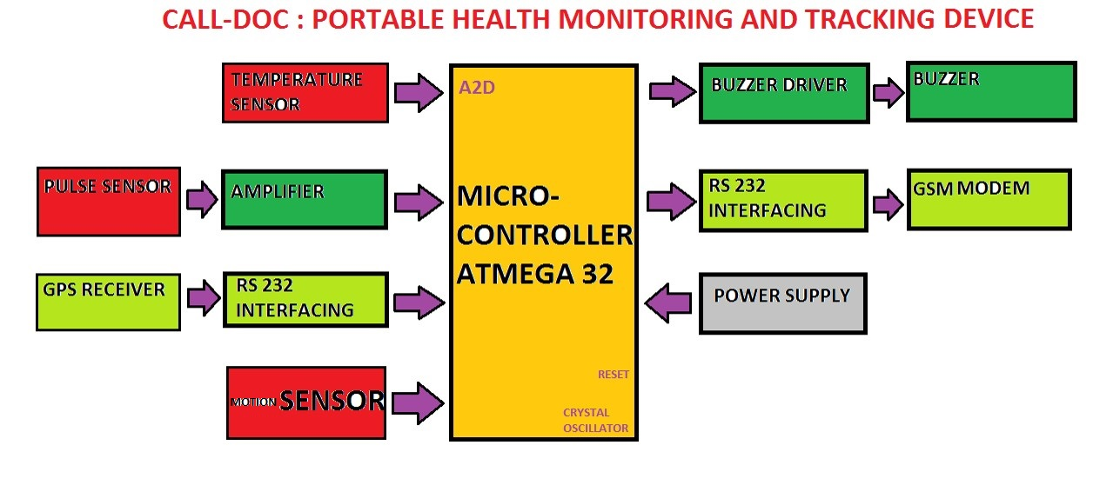
BLOCK DIAGRAM

Slide 8
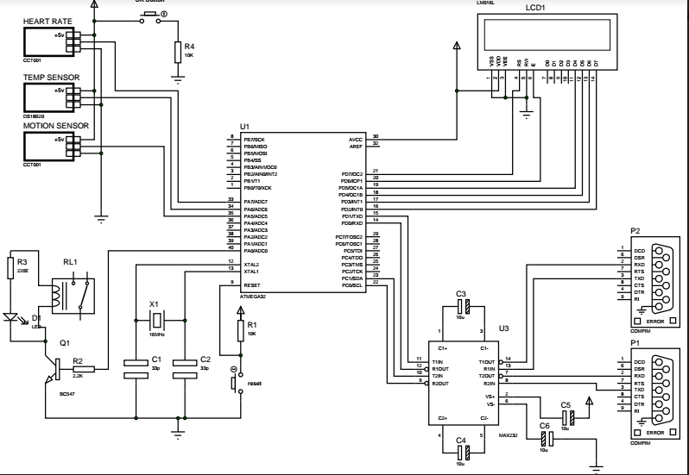
Circuit diagram

Slide 9
WORKING
This project describes the design of a simple microcontroller based pulse rate, body temperature, motion sensing and measuring device with LCD output.
Total 4 inputs are present is this device
pulse rate sensor for measurement of heart rate
body temperature sensor
motion sensor
GPS for location
The device alarms when the pulse rate & the body temperature goes below or exceed the provided threshold lower and upper limits and also when he moves or falls from his position.
This threshold upper and lower limits are defined by the programmer at the time of programming the microcontroller.
The threshold value given for the project is as 50 to 170 pulses per minute for heart beat indication & above 98°F for temperature.

Slide 10
This information i.e. the pulse rate, motion & the Body Temperature is then transmitted wirelessly to the doctor which is not in the vicinity of the patient through GSM technique along with the location.
Hence if the person on the wheelchair falls off the chair or faces any medical problem then an alert message along with his/her location is immediately send to the predefined numbers in the system.

Slide 11
PROGRAMMING
STEP 1: Initializing – header files , reset button, attendant button, sensors, lcd and gps & gsm .
STEP 2: set up lcd’s columns and rows
STEP 3: gps location
STEP 4: DS18B20 temperature sensor
Threshold value >98 Fahrenheit
STEP 5: heart beat sensor
if (bmpRate>200) || (bmpRate<40)
{ bmpRate=0; bmpCount=0; } else {
bmpCount++; average=averate+bmpRate;
if (bmpCount==2) { bmpCount=0; bmpRate averate/2;

Slide 12
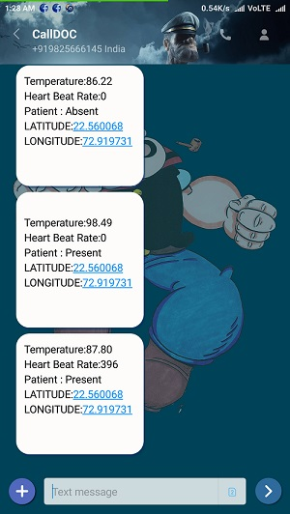
STEP 6: Motion sensor
if(digitalRead(obj)==High) --------- Present
else ------------------------------------------------- Patient absent
Step 7:Set SMS format

Slide 13
List of Components
Resistors,"R1",10K,1/-
Resistors,"R4",10K,1/-
Resistors,"R2",2.2K,1/-
Resistors,"R3",220E,1/-
Capacitors,"C1",33p,3/-
Capacitors,"C2",33p,3/-
Capacitors,"C3",10u,5/-
Capacitors,"C4",10u,5/-
Capacitors,"C5",10u,5/-
Capacitors,"C6",10u,5/-
Integrated Circuits,"U1",ATMEGA32,350/-
Integrated Circuits,"U3",MAX232,35/-
Transistors,"Q1",BC547,5/-
Diodes,"D1",LED,2/-
"LCD1",16*2 LCD,150/-
"P1",GSM SIM900,1200/-
"P2",GPS SIM28,1500/-
"RL1",Relay,40/-
"X1",16MHz,Crystal,15/-
Heart Rate Pulse Sensor,950/-
"DS18B20", Temperature Sensor,180/-
Motion Sensor,150/-

Slide 14
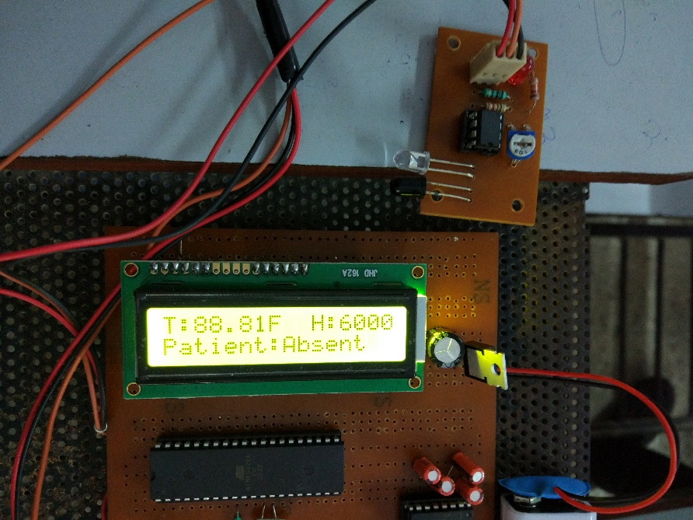
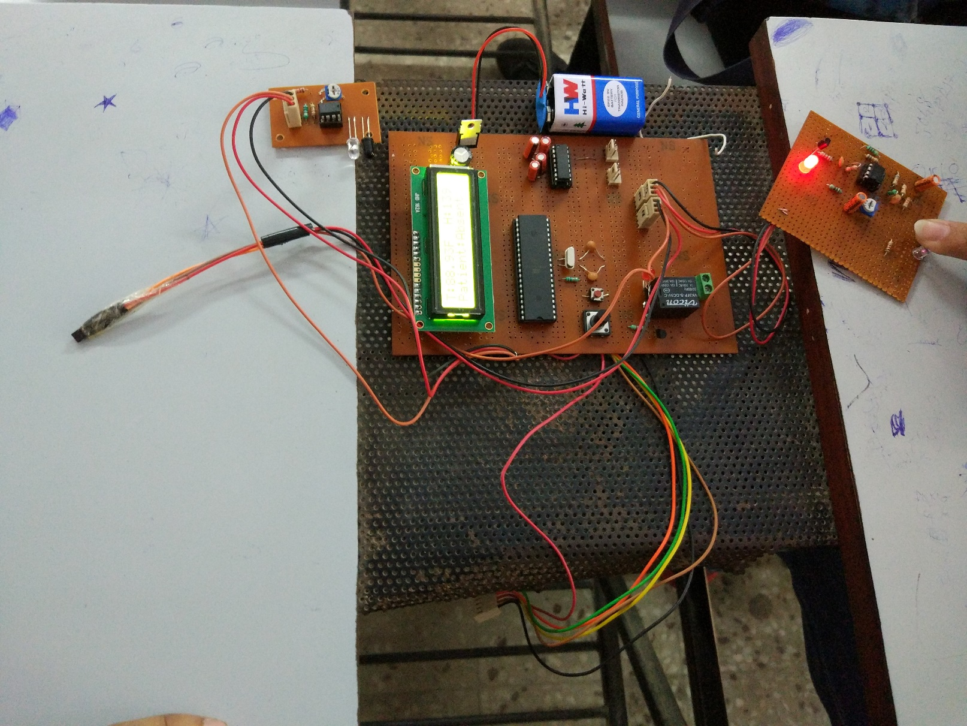
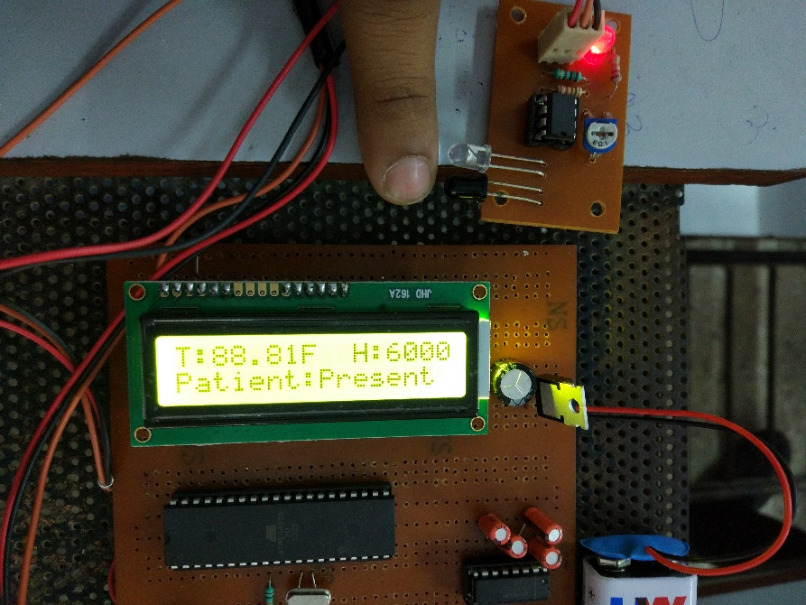

Slide 15
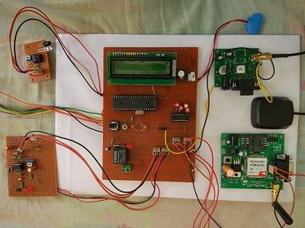

Slide 16
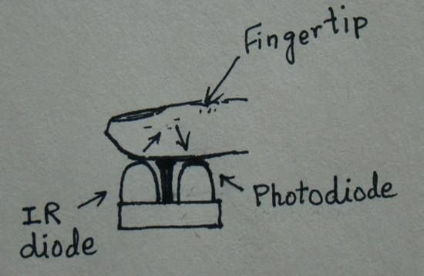
PULSE SENSOR
The sensor unit consists of an infrared light-emitting-diode (IR LED) and a photo diode, placed side by side, and the fingertip is placed over the sensor assembly, as shown below.
The IR LED transmits an infrared light into the fingertip, a part of which is reflected back from the blood inside the finger arteries.
The photo diode senses the portion of the light that is reflected back.
The intensity of reflected light depends upon the blood volume inside the fingertip.
So, every time the heart beats the amount of reflected infrared light changes, which can be detected by the photo diode. With a high gain amplifier, this little alteration in the amplitude of the reflected light can be converted into a pulse.

Slide 17
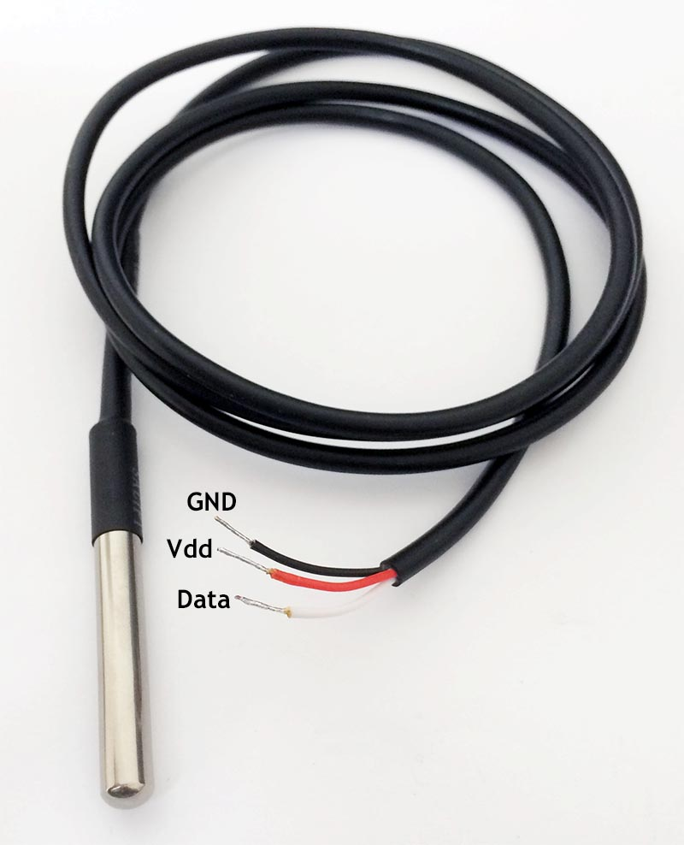
TEMPERATURE SENSOR DS18B20 DIGITAL THERMOMETER
Measures temperatures from -55°C to +125°C. Fahrenheit equivalent is -67°F to +257°F.
±0.5°C accuracy from -10°C to +85°C
Thermometer resolution is programmable from 9 to 12 bits.
Can be powered from data line. Power supply range is 3.0V to 5.5V
Zero standby power required

Slide 18
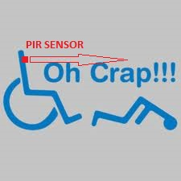
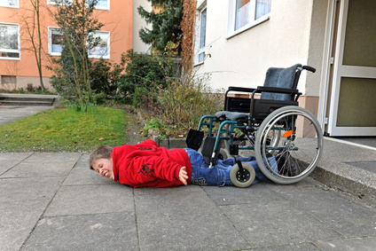
MOTION SENSOR
Detection of motion of patient on bed or wheelchair.
If patient falls off from the wheelchair then this sensor will detect his motion and alert his mentor about it.

Slide 19
WHAT MAKES IT DIFFERENT FROM OTHERS
GSM for long range transmission and reception. (Bluetooth and Wi-Fi has limited coverage area)
GPS for location.
Suitable for remote areas
Sense motion of the patients
It can be used by disabled people on wheelchair and soldiers (during war).
Further modification is easily possible. (more sensors can be added)
Cost effective and low power requirement.
Digital outputs.
This device calls automatically on detection of a condition that requires any medical attention.
Portable

Slide 20
EXISTING DEVICES
NAME | BRIEF
Health monitoring using Wi-Fi | High speed and high data rate transmission. Range 100-200m Not portable
Soldiers tracking | Continuous location tracking Portable
Systems and devices for emergency tracking and health monitoring | For disabled people and senior citizens ARM 7 microcontroller Wi-Fi
Tracking and monitoring system | Wrist band structure GSM and GPS technology

Slide 21
CONCLUSION
This project presents implementation and design of wireless sensor network for real-time health and location monitoring system by using GPS and GSM wireless module and demonstration of pulse rate, patient’s body temperature and motion.
The product is designed for reducing the cost and size, larger range using GSM, portability, location tracking using GPS.
Overall the project will be helpful for the patients as they are being continuously monitored and doctors/nurse/guardians as they can continue their own work and feel free and also make the patients independent.

Slide 22
REFERENCES
http://www.societyofrobots.com/
http://www.gadgetronicx.com/pir-motion-sensor-interface-with-avr/
www.projectsofatmega32.com/patient-monitoring-through-gsm-modem/
www.ieeexplore.ieee.org/document/7460394/
www.projectsofatmega32.com/soldier-tracking-system-using-gps-and-gsm-modem/
www.nevonprojects.com/gsm-patient-health-monitoring/
www.cecs.wright.edu/cart/wearable-portable%20health%20monitoring%20system.html

Slide 23
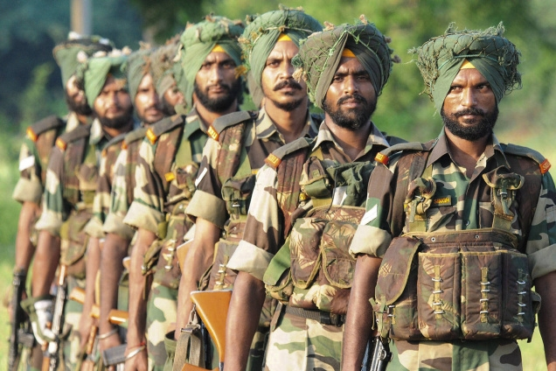

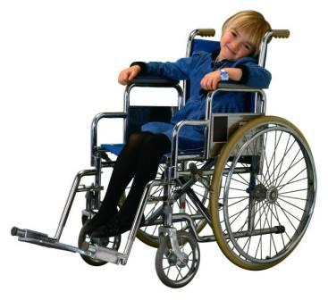
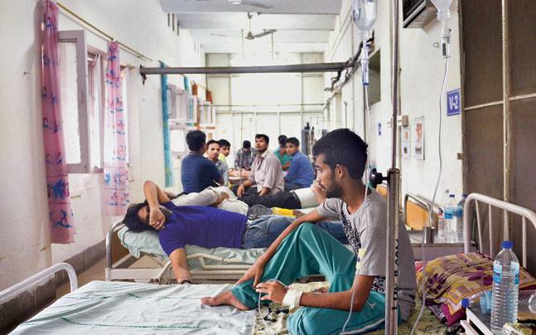
THANKYOU
CALL MY DOCTOR

